Slide 1





“The importance of introducing energy efficiency in all development sectors. Examples of Energy Efficient Technologies for the Business Sector”
PreparedFurkatKadyrov
December 23, 2021
Notes:
cover page

Slide 2

Profile of Tajhydro. Services. An experience. Flagships
Energy efficiency. Difference. Examples. History
Electricity consumption in Tajikistan
IEA and energy efficiency classification
  Development incentives
  Drivers
  Barriers
Relevance of the problem
Project on Advanced Accounting System, Tajhydro conclusions
INTRODUCTION

Slide 3
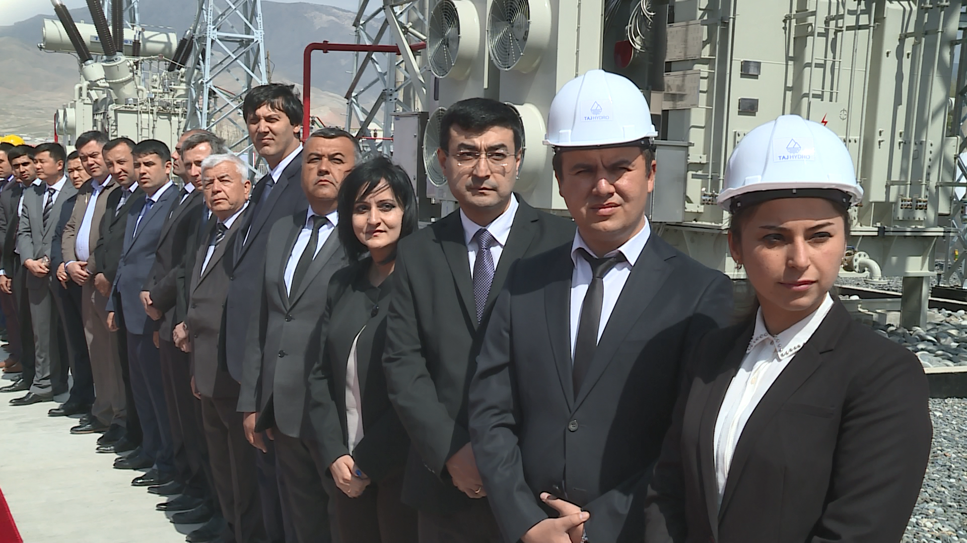
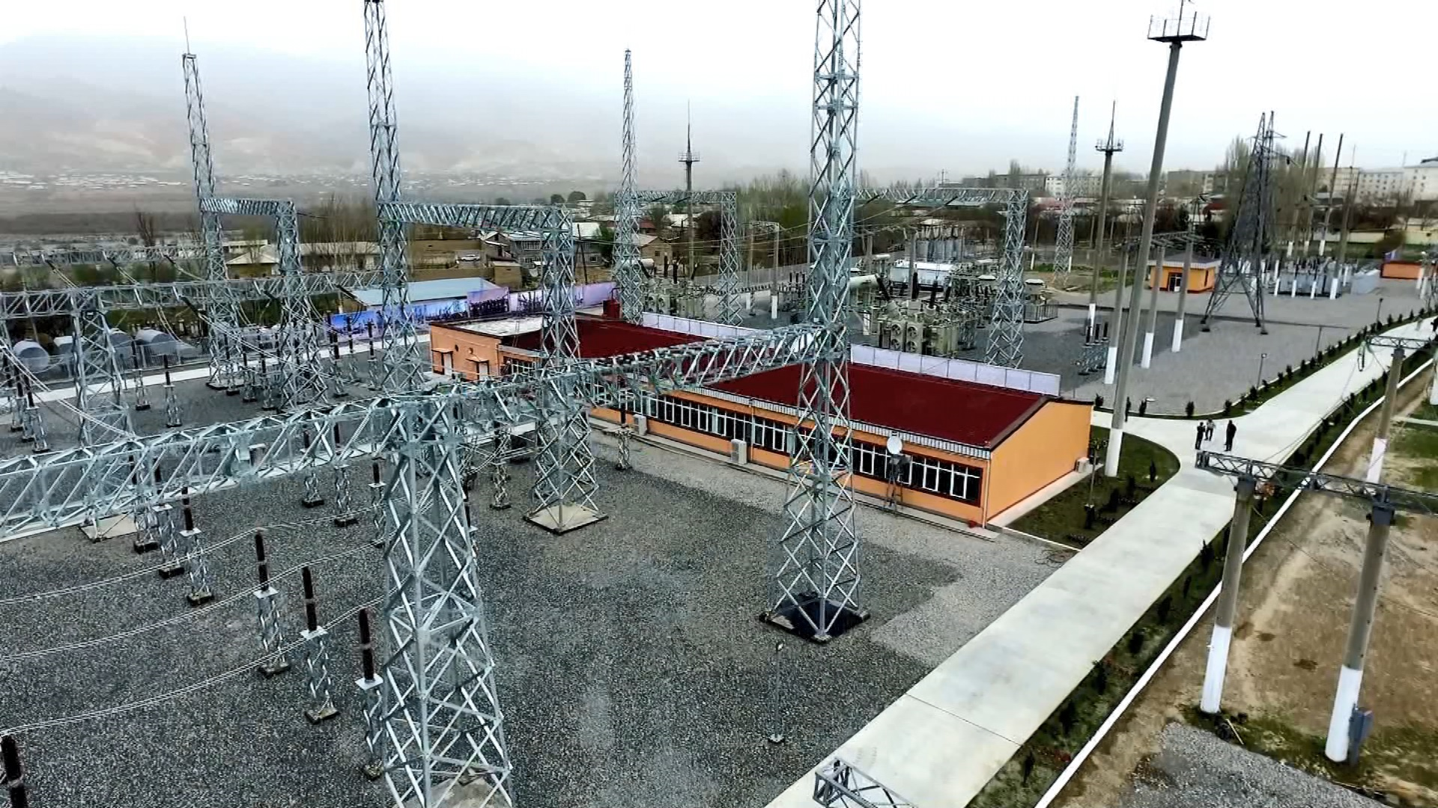
Feasibility Study
Financial Modeling
Preparation of tender documents
Environmental Assessment
Energy audit
Social Expertise
Strategic planning
Gender Policy
Services
Corporate development
Project Management
Recruitment HR
Public Private Partnership

Slide 4

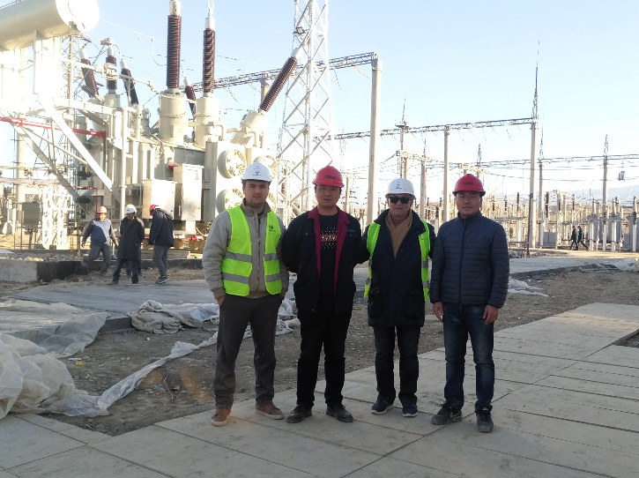
30 successfully completed projects
11 current projects
  3 gender policy projects
  1 transport project
5 short lists
45 experts in current projects
More 200 local and international experts
More then 20 study tours to different countries
Projects

Slide 5
USAID
CASA-1000 Secretariat Support
ADB
External Management of the Barki Tojik
Distribution Company
ADB
Power Sector Development Program
Advanced Metering Infrastructure
EBRD
Improving the Resilience of Tajikistan's Hydropower Sector to Climate Change
ADB
Wholesale Metering and Transmission Reinforcement Project
USAID
Power the Future - Charsem
Current projects

Slide 6
Efficient (rational) use of energy resources
Еnergy efficiency VS energy saving
EE devices / technologies
For population
is a reduction in utility costs
For county
save resources, increase industrial productivity and competitiveness
For Ecology
limitation of greenhouse gas emissions into the atmosphere
For Industrial Companies
For Energy Companies
reduction of fuel costs and unreasonable construction costs
reduction in the cost of production
energy efficiency
Notes:
energy efficiency —effective (rational) usage of energy resources. Using less energy to provide the same level of energy supply to buildings or manufacturing processes..
Unlike energy saving (saving, saving energy), which is mainly aimed at reducing energy consumption, energy efficiency (utility of energy consumption) is a useful (efficient) use of energy.
Energy-saving and energy-efficient devices are, in particular, systems supplying heat, ventilation, electricity when a person is in the room and stopping this supply in his absence.
Wireless sensor networks (WSNs) can be used to monitor the efficient use of energy.
Energy-efficient technologies can be applied in lighting (e.g. sulfur-based plasma lamps), in heating (infrared heating, thermal insulation materials).

Slide 7
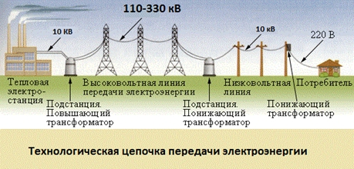
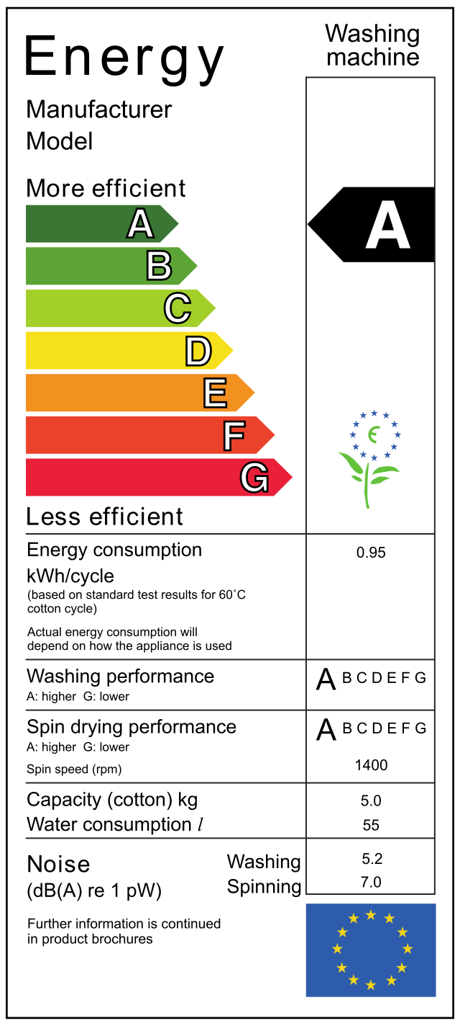
energy efficiency
The higher the energy efficiency in the initial sectors of the technological chain, the more efficient the entire chain in the aggregate
Ultimately, wasted energy is lost products, lost services, etc.
European Energy Certificate
Notes:
In continuation of the previous slide -Сonsidering a strategy for improving the energy efficiency of any process, it should be remembered that energy efficiency, as one of the key categories of any economic system, has a multiplier effect, namely: the higher the energy efficiency in the initial sectors of the technological chain, the more efficient the entire chain as a whole. The characteristics of energy efficiency in the fuel and energy complex, in particular, in the electric grid complex, are of the greatest importance.After all, in the end, wasted energy is lost products, unprovided services, etc.
For Example European standard - energy certificate, where scale A is the most energy efficient andGleast energy efficient

Slide 8
Already in the 1970s. many countries have implemented policies and programs to improve energy efficiency.
ISO 50001 -international standard ISO 50001, which also regulates energy efficiency.
RESOLUTION of the Republic of Tajikistan dated January 27, 2015, No. 15, On the definition of an authorized state body in the field of energy saving and energy efficiency
energy efficiency
Notes:
-Beginning from1970-X gg.many country implemented politics And programs on raising energy efficiency.Today on the industrial sector account for nearly40%annual world consumption primary energy resources And about such same share world emissions carbon dioxide gas.
In systemenergy managementis an international standard created by the International Organization for Standardization. It was adopted in 2011 and updated in 2018
-According to Article 5 Law of the Republic of Tajikistan "On Energy Saving and Energy Efficiency" The Government of the Republic of Tajikistan decides:
Designate the Ministry of Energy and Water Resources of the Republic of Tajikistan as the authorized state body in the field of energy saving and energy efficiency

Slide 9
Savings of 1% per year, in US dollars only for utilities can be over
$1,000,000 per year
For industry, 1% is about
900 000 dollars
Expenses
Useful supply of electricity 2019
Notes:
In developed countries, about half of all energy is spent on construction and operation, in developing countries - about a third. This is due to the large number of household appliances in developed countries.Barki Tojik can redistribute the saved electricity to other sectors, for example, to the industrial sector, where the same benefit can almost triple, or export it, and thereby increase the same amount by 4 or even 5 times.In any case, Barki Tojik can use the saved electricity more rationally.

Slide 10
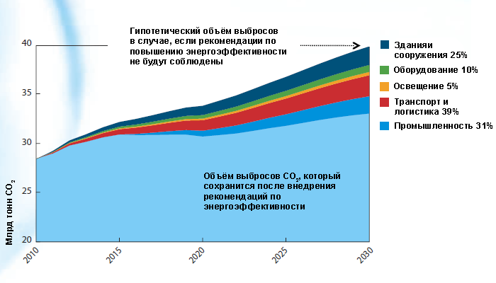
Energy efficiency classification by sector:
  Buildings and constructions
  Equipment
  Lighting
  Transport and logistic
  Industry
  Power industry
International Energy Agency
According to the IEA, in the achieved by 2030.reduction of carbon dioxide emissions by 9 billion tons
25% reduction will be obtained by improving the energy efficiency of buildings and structures
10% - equipment, 5% - lighting, 39% - transport and logistics, 31% - industry.
Notes:
According to the IEA classification, energy efficiency initiatives are broken down into the following sectors:Buildings and structures, Equipment, Lighting, Transport and logistics, Industry, Power industry25 recommendations for improving the energy efficiency of national economies. According to the IEA, in the achieved by 2030.reduction of carbon dioxide emissions by 9 billion tons. 25% reduction will be obtained by improving the energy efficiency of buildings and structures,10% - equipment, 5% - lighting, 39% - transport and logistics, 31% - industry. Thus, energy efficiency is seen not only as a way to reduce the energy intensity of the world economy, but also as a key to comprehensive sustainable development and a powerful measure to combat global warming.

Slide 11

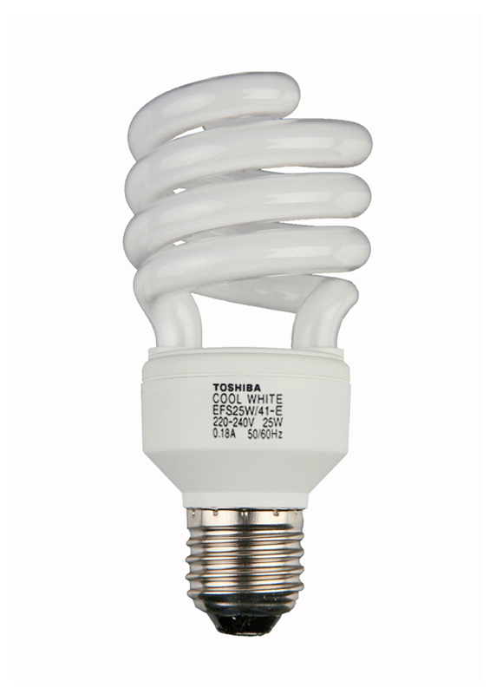


State adjustment of energy efficiency policy depending on
Socially-economic features
Climatic features
Political
peculiarities
Geographic features
Structural Features
Implementation of international energy efficiency standards
Main incentives for the implementation of energy efficiency policies
Against
Behind
Declines in exports
constriction sales market
Opening of new sales markets
Notes:
Each individual state adjusts its energy efficiency policy depending on its socio-economic, geographic, climatic, structural and political characteristics. For example, many energy exporting countries are rather passive in the field of international cooperation to promote energy efficiency, as energy efficiency improvements and coordinated energy saving efforts in oil and gas importing countries can jeopardize their export potential and narrow markets.At the same time, countries with the most advanced developments and technologies act as drivers of international cooperation - the introduction of international standards in the field of energy efficiency can open up huge markets for their corporations.

Slide 12
Energy security
Economic development and
competitiveness
Changing of the climate
Public health
Drivers
Main drivers of energy efficiency
Notes:
The IEA identifies the following common drivers for most countries to intensify state policy in the field of increasing the energy efficiency of the economy:Energy security
• reduction of energy imports.
• reducing domestic demand in order to increase exports.
• improving the reliability of supplies and the sustainability of the energy system.
• controlling the growth of demand for energy
Economic development and competitiveness
• reduction of energy intensity.
• Increasing the competitiveness of the industry.
• reduction of production costs.
• increasing affordability of prices for energy consumers
Changing of the climate
• contribution to global mitigation and adaptation action.
• fulfillment of international obligations under the UN Framework Convention on Climate Change (UNFCCC).
• compliance with accession requirements or directives of a supranational nature (e.g. EU)public health
• reduction of pollution in residential premises and in the environment

Slide 13
Market
Technical
Financial
Regulatory and institutional
Informational
barriers
Key Barriers to Energy Efficiency
Notes:
IN then same time on the way raise energy efficiency economy often get up barriers financial,informational,technical,market And institutional character.
IEA suggested next classification barriers on the way raise energy efficiency
Barrier Examples
Market
•organization market And price imbalances interfere consumers in complete measure estimate the effect from energy efficiency
•Problems,related from conflict interests,emerging,if investor not maybe take advantage benefits from raise efficiency(IEA2007but)
•expenses on the implementation programs energy efficiency(price development project exceed benefits from savings energy)
Technical
•absence available technologies energy efficiency,suitable under local terms
•inadequate potential definitions,development,implementation And maintaining investment in energy efficiency.
Financial
•in advance incurred expenses And long-term payback reduce interest investors
•perception investment in energy efficiency how complex And risky from high initial investments
•absence awareness about financial benefits co sides financial institutions
Regulatory And institutional
•tariffs on the energy not stimulate investment in EE
•structure incentives encourages energy companies ramp up sales energy,but not invest in energy efficiency
•institutional slope in side investment,oriented on the sentence
Informational
•absence sufficient information And understanding co sides consumers for acceptance decisions about rational use And investments

Slide 14
Increase industrial competitiveness through energy savings in logistics and production;
Reduction of budget expenditures due to efficient energy management and reduction of energy losses;
Improving the state of the environment and public health.
Tajikistan will be able to earn through the mechanisms of trade in quotas for CO2 emissions.
The relevance of the problem of improving the energy efficiency of the Tajik economy
Notes:
The World Bank defines the following main Benefits,which will receive Tajikistan from implementation measures on raising energy efficiency economy:
Raise industrial competitiveness behind check savings energy in logistics And production;
Reduction expenses budget,thanks to effective management energy resources And decrease energy losses;
Improvement states environmental environments And health population.
Tajikistan will be able earn order across mechanisms trade quotas on the emissions SO₂.

Slide 15

Energy Sector Development Program
Advanced Accounting System
Dushanbe (main) -Khujand(Reserve)
Panjakent
Dangara
Buston
Konibodom
Istaravshan
Isfara
Substations
Transformers
NE and HB lines
Counters
CSP project
Notes:
The project is financed by ADB and the budget is 65 million dollars. USA. This project is an integrated approach (repair of potencies, transformers, replacement of mediumvoltand low-voltlines) to reduce energy losses. According to some reports, they reach up to 32% (both technical and commercial). An example is a project in Khujand, which, before the implementation of a similar project, had losses of 25-28%, and today, the project has been successfully operating for a year now, losses are 8-9%.
This project includes 6 cities and 3 districts of the city of Dushanbe, where Dushanbe will have the main accounting system, and Khujand will have a backup system for all the country. As well as preparing a feasibility study and attracting finance for another 40 cities of the country.

Slide 16
part of an efficient resource management strategy
solution for economic, political, social and environmental issues.
driver of job creation, green growth and global sustainability.
for green growth and global sustainable development
occupies an important place in the socio-economic and energy development strategy of Tajikistan.
energy efficiency
conclusions
Notes:
The desire of the world community for sustainable development makes energy efficiency as part of an effective resource management strategy.
Today, in the conditions of energy market instability, oil price volatility and the redistribution of roles in the global energy arena, energy efficiency is the most obvious and prompt solution for a number of economic, political, social and environmental issues.
Also, energy efficiency can become a driver of job creation, high-tech research, energy security, green growth and global sustainable development.
Energy efficiency is on the agenda of the governments of the world's largest countries, corporations and supranational institutions and occupies an important place in the socio-economic and energy development strategy of Tajikistan. Tajikistan has a huge potential for implementing energy efficiency solutions, the importance of this topic is recognized at the highest state level and included in the National Development Strategy 2030.Optimization of the use of energy resources will free up significant financial resources that can be directed to the development of the national economy in a number of other areas

Slide 17
WWW.TAJHYDRO.TJ

